Slide 1

Machine Learning Models For Predicting Heart Disease In Patients
Lecturer: Prof. Boaz Lerner
Presnted by:
Names: Inbal Karibian, Adi Yogev Golbari and Arad Peleg

Slide 2
Introduction
Heart disease is a one of the leading causes of death worldwide.
Accurate diagnosis is crucial due to the disease's complexity.
Solution
Use exploratory data analysis (EDA) and various classification algorithms.
Develop a machine learning tool for early diagnosis and risk assessment of heart disease.

Slide 3
Business Understanding
1. Healthcare Industry Overview:
Heart disease causes 17.9 million deaths annually (WHO).
Significant healthcare costs, e.g., $239.9 billion per year in the US.
2. Strategic Goal:
Improve patient outcomes through early diagnosis and intervention.
Reduce healthcare costs by accurately identifying at-risk individuals.
3. Current Situation:
Heart disease influenced by genetics, lifestyle, and physiological factors.
Complex diagnosis process; automation can help improve accuracy and efficiency.

Slide 4
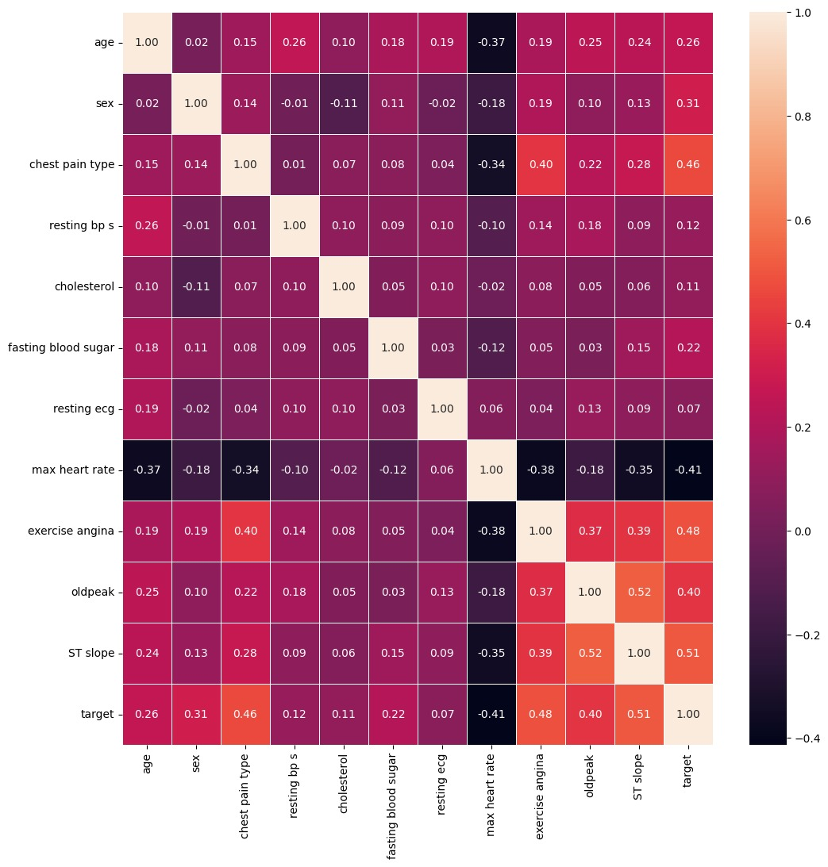
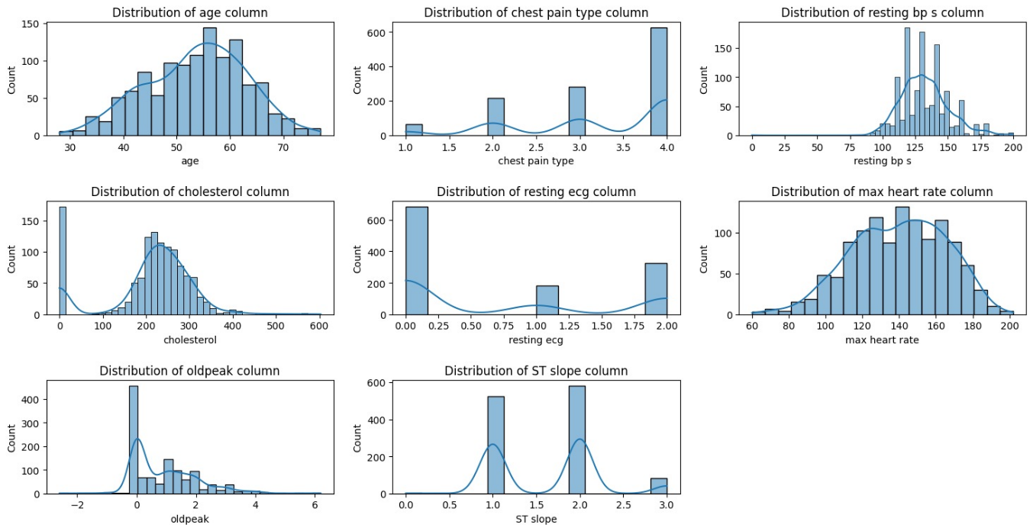
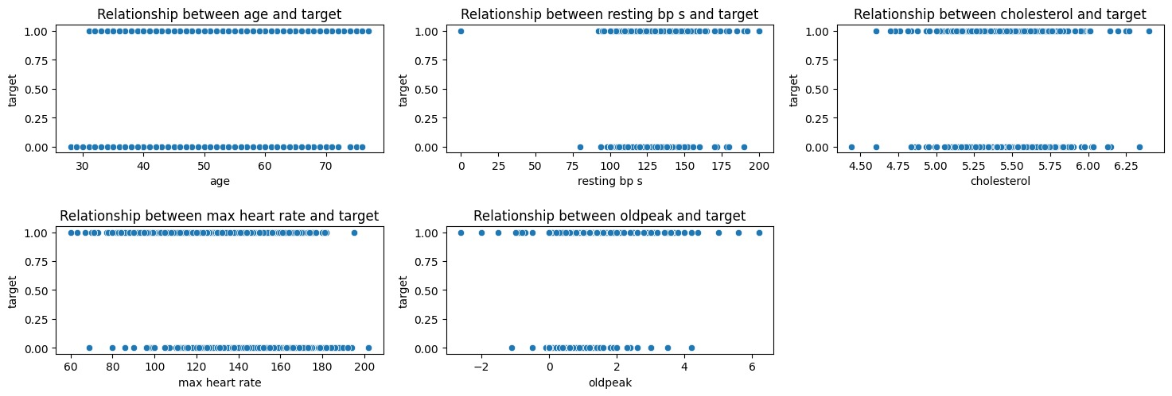
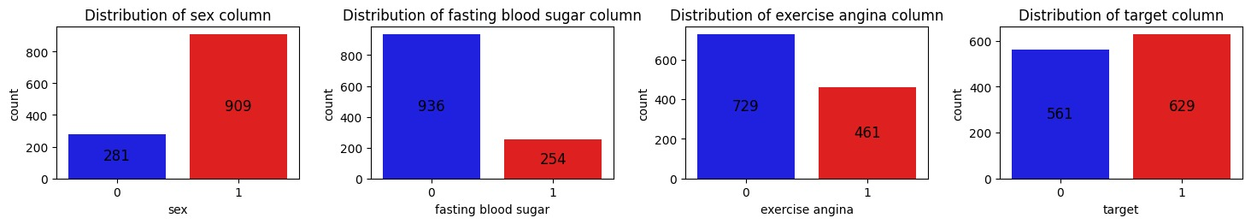
Data Understanding
Data Exploration:
1. Data collection:
Dataset from Kaggle combining five heart disease datasets.
Includes patient data from Cleveland, Hungary, Switzerland, Long Beach, and Statlog.
2. Data Explanation:
1190 observations with 11 common features.
Target variable: 1 (heart disease), 0 (no heart disease).
Features divided into categories: Demographic, Symptom-related, Clinical Measurements, ECG Results, Exercise-related, Diagnostic Measures.

Slide 5
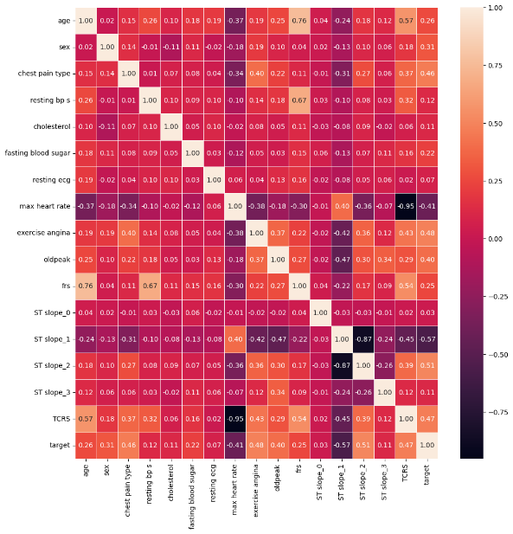
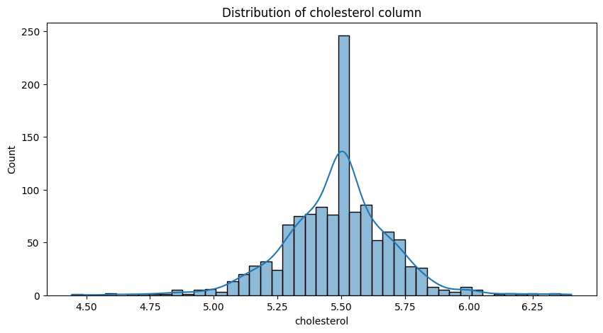
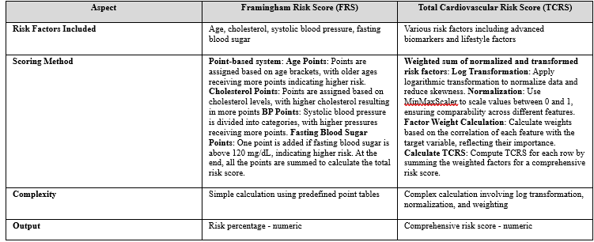
Data Preparation
Data After Change:
1. Data Selection:
Use 'target' attribute for heart disease prediction.
2. Filling Missing Values:
No missing values but handled '0' values in cholesterol by replacing them with mean values and applying log normalization.
3. Data Construction:
Created Framingham Risk Score (FRS) and Total Cardiovascular Risk Score (TCRS).
These scores enhance the dataset with real-world medical risk assessments.
4.Data Formatting:
Converted ST slope: categorical feature to binary for better analysis.

Slide 6
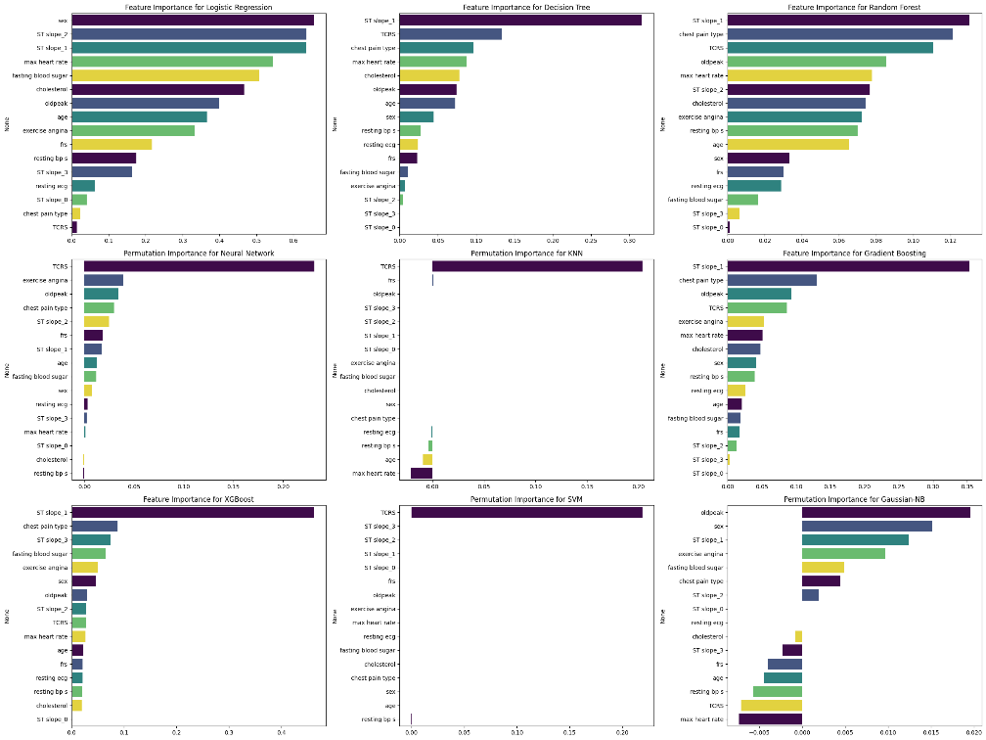
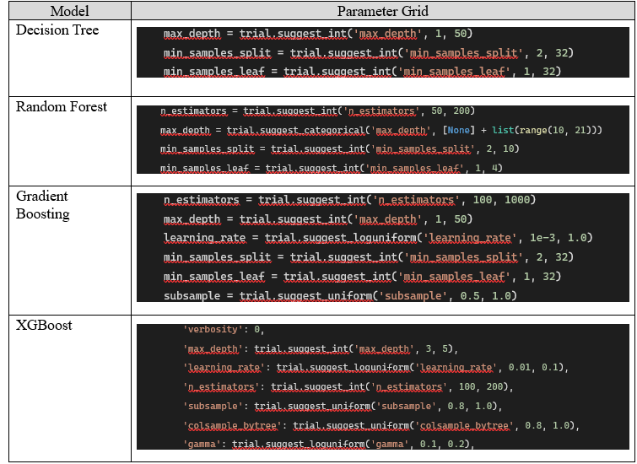
Modeling
Feature Importance :
1. Models Used:
Tested models: SVM, Decision Tree, KNN, Naïve Bayes, Logistic Regression, Random Forest, XGBoost, Gradient Boosting, MLP.
Chose models based on literature and their effectiveness in medical data analysis.
2. Importance of Features:
Used built-in feature importance for some models.
Permutation importance for others.
Identified top features: ST slope, TCRS, chest pain type, oldpeak.
3. Hyperparameter Tuning:
Used Optuna library for tuning top four-performing models.
Using Grid search and cross-validation with 300 trails for Decision Tree, Random Forest, Gradient Boosting, and XGBoost.
Hyper Parameter Tuning:

Slide 7
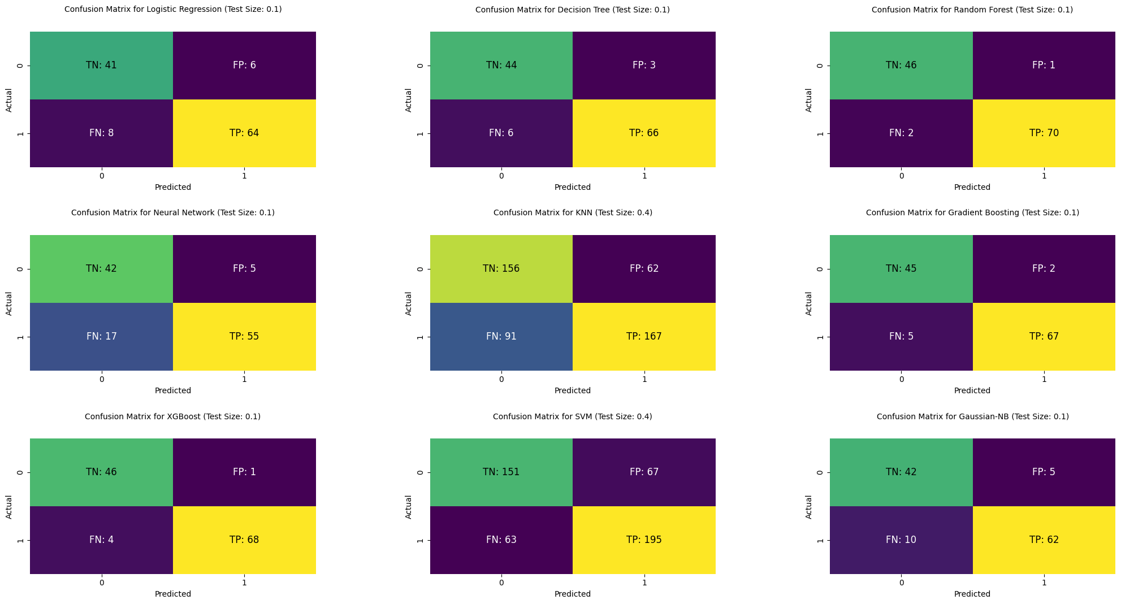
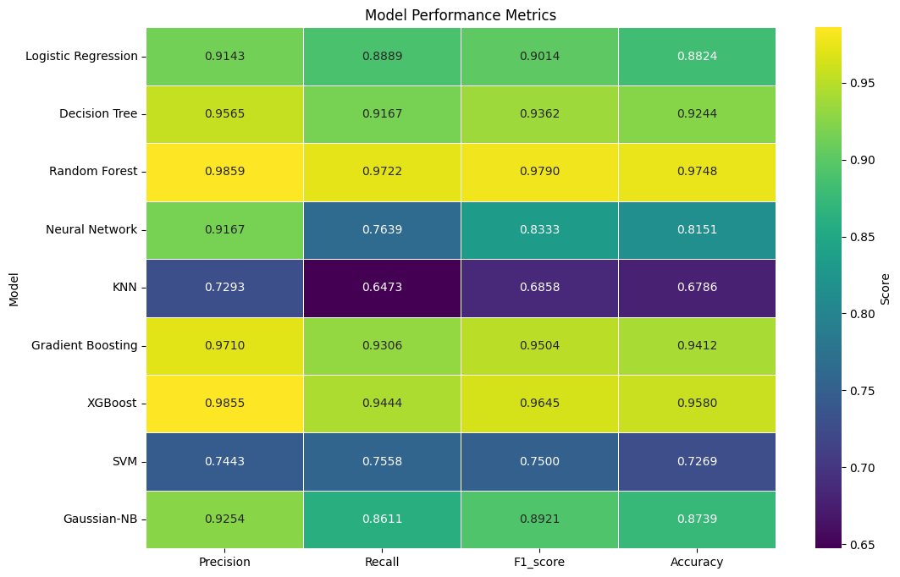
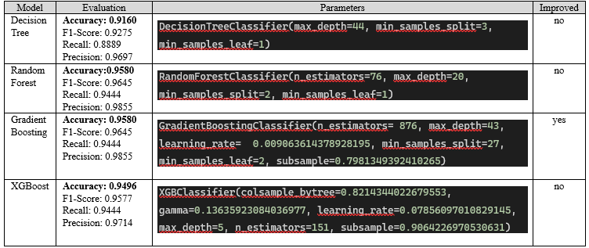
Evaluation
Confusion matrix for base models:
1. Metrics Used (Based on confusion matrix):
Accuracy – main metric
F1-score
Recall
Precision
2. Best Models:
Random Forest: Accuracy 97.48%.
Gradient Boosting: Improved performance post-tuning with 95.80% accuracy.
Did not include cross validation for better performance on both cases (Base models, hyper tuned models)
Evaluation results base models:
Evaluation results base models:

Slide 8
Discussion and Conclusions
1. Summary of Findings:
Random Forest most accurate model with 97.48% accuracy.
Limited improvement from hyperparameter tuning for some models.
2. Impact of Tuning:
Highlight specific improvements in Gradient Boosting. from 94% to 95% in accuracy after tuning.
3. Future Work:
Research more on heart disease literature.
Experiment with advanced tuning techniques.
Incorporate additional features and more data for better accuracy.

Slide 9
Thank You For Listening!

Slide 10
Bibliography
Jindal, H., Agrawal, S., Khera, R., Jain, R., & Nagrath, P. (2021). Heart disease prediction using machine learning algorithms. IOP Conference Series: Materials Science and Engineering, 1022(1), 012072. https://doi.org/10.1088/1757-899X/1022/1/012072
Katarya, R., & Meena, S. K. (2021). Machine Learning Techniques for Heart Disease Prediction: A Comparative Study and Analysis. Health and Technology, 11(1), 87–97. https://doi.org/10.1007/S12553-020-00505-7/TABLES/3
Shah, D., Patel, S., & Bharti, S. K. (2020). Heart Disease Prediction using Machine Learning Techniques. SN Computer Science, 1(6), 1–6. https://doi.org/10.1007/S42979-020-00365-Y/TABLES/3
Soni, J., Ansari, U., Sharma, D., of, S. S.-I. J., & 2011‏, undefined. (n.d.). Predictive data mining for medical diagnosis: An overview of heart disease prediction‏. Academia.Edu‏J Soni, U Ansari, D Sharma, S Soni‏International Journal of Computer Applications, 2011‏•academia.Edu‏. Retrieved June 15, 2024, from https://www.academia.edu/download/79534142/5a18f6653b56138cd5196d20e2f39de189e3.pdf

